Slide 1
The Living Cosmos - from Oak Trees to the “Big Bang”
Chris Clarke
(via quantum theory)
My (variegated) spiritual practice
what
how
Relaxation response
Mental quieting
Posture, breath
Mantra, awareness
Opening (absorption into the larger)
Listening
(relationship with the particular)
α – rhythm
ritual, contemplation
Questing & waiting
Other senses (touch, smell, sound)
Notes:
* Addition to title – via quantum theory
Focus on spiritual practice – so start with my own
It’s not systematic or regular, but it still is a vital part of my life, and one that has grown with time. I find myself needing (or coming across) different spiritualities at different times
* I tend to start in the same way – relaxation followed by quieting –
* may use different ways of achieving this ...
This can lead on to different strands, depending on what my inner needs are (not necessarily conscious).
* One is Listening – with the “inner ear” as well the outer
NB Relationship
* (Questing and waiting) Meeting in our house next to Southampton Common. * Deadlocked discussion. All went onto common to follow whither they were drawn, holding a particular question. Successful outcome.
[That could equally well be described in terms of the ambience ...]
*could involve other senses
(Other senses) (Oak tree – bones – through bodilly sensation
the copse – being absorbed by the silent Being-for-itself of the copse.
A deeper way is through silence. NOT holding a question; asking through silence and being answered through silence.
* (b) Opening. Internal journey –
The “how” of this:
Curiously, the way in (to oneself) is also the way out (to the most all embracing context)

Slide 2
The Living Cosmos - from Oak Trees to the “Big Bang”
The way in is the way out
Alan Wallace:
“[One can] so profoundly settle the mind that virtually all thoughts and other mental constructs become dormant. ...the culmination of this meditative process ... is characterized by three essential traits: bliss, luminosity and non-conceptuality.”
“... there is no distinct experience of a division between subject and object ...”
Meister Eckhart:
“God must become utterly I, and I utterly God, so fully one that this ‘he’ and this ‘I’ become and are one ‘essential is’.
Notes:
on: way in = way out
Two quotations – first from Alan Wallace
* What he describes (ālaya – analogous to Tibetan rigpa) Alan Wallace is not just describing a special subjective way of perceive, but a non-dual state in which the perceiver and the perceived are the same
* - (there is no distinct .... Separation) going into the depths of the self is the same of going into the breadth of the cosmos. Recognising that “tat tvam asi”
Meister Eckhart * expressed the same thing in Christian terminology
Here it’s worth noting that, although in one sense he is talking about (traditionally Philokalia) “the beatific vision” – but there are innumerable steps on Jacob’s ladder before that.
I believe that there are foretastes, which gives the temerity to cite this myself.

Slide 3
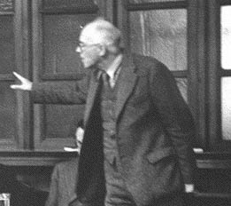
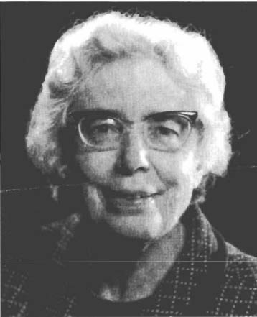
The Living Cosmos - from Oak Trees to the “Big Bang”
Science and spiritual practice
Margaret Masterman, Dorothy Emmett, Frederick Parker-Rhodes, Ted Bastin, Geoffrey Keeble, Richard Braithwaite, ...
The Epiphany Philosophers (Journal: Theoria to Theory)
“How could one experimentally verify whether or not the mass had worked?”
The real problem: inappropriately handling different ways of knowing
This is the main obstacle to dialogue between science and spiritual practice.
Notes:
To return to my own history – how does science fit into this?
* EPs – bringing Sci & Spi together . Spiritual practice was in part meditation, in part liturgy
* How could one experimentally verify whether the mass had worked?
One could regard this question as merely absurd – as a crass categorical error, like “Looking for verbs in the refrigerator” (to quote another phrase I heard in connection with them)
But actually is was a profoundly creative move (a sort of Koan): starting from the idea that at least some spiritual practices could interface in some way with some aspects of science – where would you draw the line? And what exactly is it that makes one thing that makes the questions “How could ...” beyond the pale?
* (The real problem ...) (WOK to be discussed shortly)
* (Main obstacle)

Slide 4
The Living Cosmos - from Oak Trees to the “Big Bang”
Cognitive subsystems (Teasdale and Barnard)
Body
State
subsystem
Also The Master and his Emissary : Iain McGilchrist
Relational
subsystem
Auditory
ss.
Relational
Memory
Visual
ss.
Propositional subsystem
Verbal
ss.
Propositional
Memory
Notes:
So what do I mean by “ways of knowing”?
We are constructed (through evolution) so as to have two distinct main ways of knowing, based on two main subsystems of the brain / mind
SMN will know these through
*Iain McGilchrist
But I will use the terminology of the similar
*
a diagram of some of the processing subsystems in the brain, according to Teasdale and Barnard - based on research on cognitive processing. .
I am going to concentrate on the two large ones here - p and r.
p = verbal based logical reasoning - with a verbally coded memory store.
r= holistic, overall meaning processing. Direct connections with sense modalities (in contrast to p) and a memory store coded in every sensory modality - vivid and immediate. The connection with emotional response made possible by the direct connection with state of bodily arousal.
For complete processing, you need both working in close communication. Because the systems are distinct, it is possible for this communication to become overloaded or skewed in some way.
This helps to explain a lot of what goes wrong for human beings.

Slide 5
The Living Cosmos - from Oak Trees to the “Big Bang”
Science and spiritual practice - resumed
Problems:
Overcoming incommensurability –
modelling
– alternative logic
Where to start?
What can provide the necessary “traction” to shift the science/spirituality debate?”
“Consciousness”
– provided we choose an appropriate sense to this word
Notes:
How do we use this insight to enable science and spirituality to engage appropriately with each other?
*The basic problem is the incommensurability of the propositional and the implicational
* The way round is through modelling
* The result is the emergence of alternative logics
* so where are we to start ...
* consciousness

Slide 6
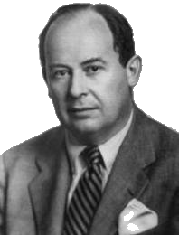
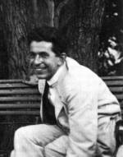
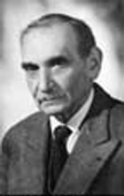
The Living Cosmos - from Oak Trees to the “Big Bang”
“Consciousness” enters the discussion
How not to handle consciousness ...
E.g. Dennett - consciousness is merely the current rough draft of a cognitive analysis. This is an implicit denial of the relational
Physics
Consciousness
Being
John Von Neumann (1932)
- Basic mechanism of quantum observation
Fritz London & Edmond Bauer, 1939 - Consciousness
Notes:
* How not to do it: by defining conc. in such a way as to deny the existence of any way of knowing other than the propositional
Adopting the viewpoint of cog subsystems suggests consciousness as involving being , and most strongly linked to the relational side, while physics involves the propositional, in a complementary manner
* “Physics - conciousness - being”
I will concentrate here on one particular – and controversial - strand of thought which uses quantum physics to make a link between physics and consciousness
*
*
So what is the idea, in more detail ... ?

Slide 7
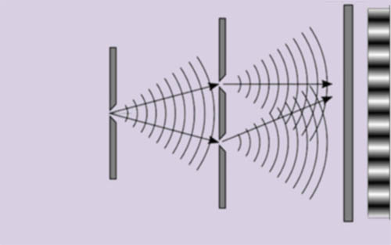
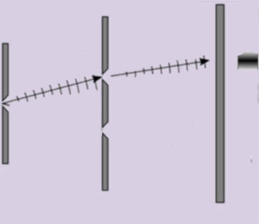
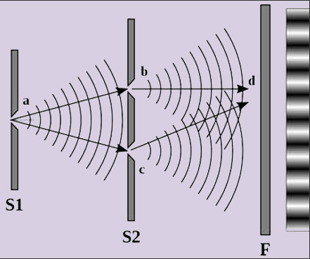
The Living Cosmos - from Oak Trees to the “Big Bang”
Consciousness according to London & Bauer
Quantum wave-function
Cumulative record of many particles
Particles
entering first slit
Notes:
The sort of physics that L & B were talking about involved experiments like this one depicted here ...
If left to run, build up an “interference pattern” indicating some sort of wave process involved in the passage of the particles. The photographic film constitutes an “observation”, and it will be subsequently examined by a human observer
On the other hand one could have an observer who was examining what was going on particle-by particle,
*
and in particular examines which slit each particle goes through. Then there is no interference:
Discussion by L & B

Slide 8
The Living Cosmos - from Oak Trees to the “Big Bang”
Consciousness according to London & Bauer
London & Bauer (1939)
A measurement is achieved only when the position of the pointer has been observed.
It is precisely this increase of knowledge, acquired by observation, that gives the observer the right to choose among the different components of the mixture predicted by the theory, to reject those which are not observed, and to attribute thenceforth to the object a new wave function, that of the pure case which he has found.
We note the essential role played by the consciousness of the observer in this transition from the mixture to the pure case.
“
”
Notes:
* London and Bauer’s pamphlet
Observation
– note terminology of observer and “pointer”
* But ??knowledge?? (propositional)
Choose – yes, but how – what does it mean? (later – asserting a context)
Mixture – von Neumann’s idea that the apparatus does not single out a particular outcome, but produces a “mixture” of different possibilities. A further process is required to obtain a particular outcome – according to L & B, the observer
“New wave function” – changing the final outcome implicates the previous events
leading up to it- an aspect of entanglement.
* Recognition – but what is “consciousness” – in what sense?

Slide 9
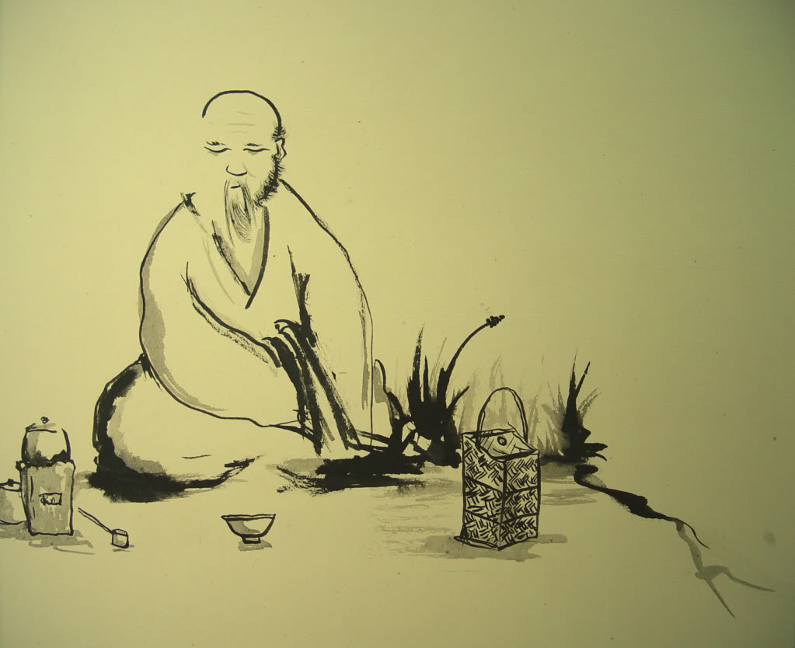
The Living Cosmos - from Oak Trees to the “Big Bang”
What consciousness does: the relational account
Does consciousness do anything?
Epiphenomenalism: consciousness is just a by-product of mechanical processes
What about wu wei?
Effective doing flows from Being; Being involves relationship, including my relationship with myself. (The role of consciousness is relational, not mechanical.)
Spiritual practice:
“Practice” is training for the real thing:
Namely, work that flows from Being.
Meister Eckhart:
“God must become utterly I, and I utterly God, so fully one that this ‘he’ and this ‘I’ become and are one ‘essential is’, and in this essence eternally work one work.”
This work is Being – which for Eckhart creates through “ebullitio”
Notes:
What does L & B’s argument look like from the relational point of view? (move towards it)
*
Does consciousness in fact do anything?
*
Epiphenomenalism: consciousness merely supplies a subjective gloss on top of purely mechanical processes
*
Non-action (wu wei) is an important principle: partly agrees with epip, but it affirms that we do make a difference, but this is more by being (the relational) than by force (the propositional).
(the sein Sein Seyn trap ... B=verb, b=noun)
*
Consciousness is about relationship – with people, with other conscious beings,
with yourself – with your own ideas - with the land, with the sea:
Consciousness is about establishing a relationship and standing within it
Relationship (I – Thou) is shared being
With this in mind, what does spiritual practice tell us about what consciousness does?
* “Practice” is training for the real thing
What I am has an effect, and the awareness of this is important in spritual practice.
* Work – but what does that mean? Revisit Meister Eckhart
*
* In other words. Work and being (verb) are identical - and identical with Being (God)

Slide 10
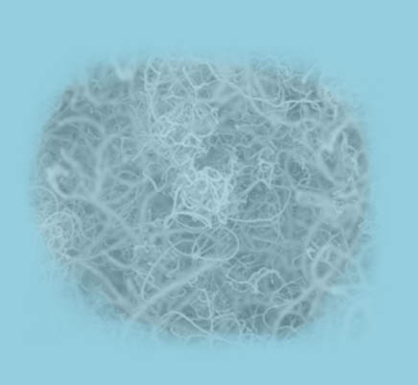
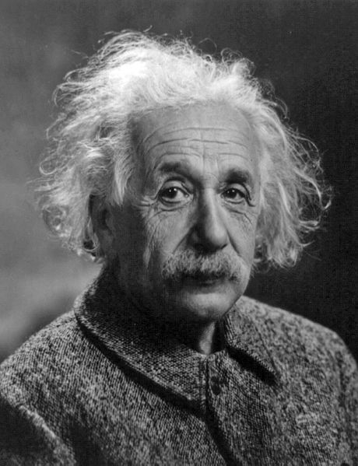
The Living Cosmos - from Oak Trees to the “Big Bang”
What consciousness does: the propositional account
We need first to know what beings are conscious
In order to do that we need some more quantum theory
Digression on entanglement:
Two systems are entangled when separate observations on them are correlated, with no physical communication or “alignment”
“Spukhafte
fernwirkung”
When any two systems interact, they remain thereafter entangled unless specifically disentangled.
Many interactions have taken place over the last 13,000,000,000 years
Notes:
How is this to be modelled in propositional terms?
Need first to know what beings are conscious, and in order to do that need some QM
* QM: Digression on entanglement: * Two systems are entangled * (As Albert remarked ... )
* Many entanglements ... Entangled ball
* Now what beings ...
Consciousness, in the sense used here, isn’t about cleverness – it’s about autonomous being – something being for itself.
So there is really no lower limit of sophistication regarding what can be conscious and what not – a principle of pan-psychism -

Slide 11
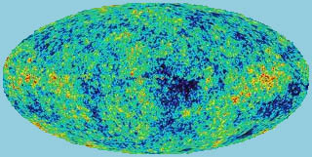
The Living Cosmos - from Oak Trees to the “Big Bang”
What consciousness does: the propositional account, continued
What beings are conscious?
With this sense of consciousness there is no “lower limit” – “panpsychism”
But we need to rule out aggregates:
the internal entanglement of a conscious being is organised
Conscious beings can overlap:
In physical theories, smaller units can be nested within larger ones (Hameroff & Penrose)
Self-examination suggest that we have a “compound I” (Lockwood)
Open issues:
The whole universe is a Being in a pure state
(Evidence: WMAP) - Cf. “The body of God” (Primavesi)
Notes:
* Now return what beings ...
Speculative, in sense the (though there is a clear intellectual structure) there is no concrete evidence
Consciousness, in the sense used here, isn’t about cleverness – it’s about autonomous being – something being for itself.
So there is really no lower limit of sophistication regarding what can be conscious and what not – a principle of pan-psychism –
***** etc
Nesting allows us to enter into relationship – a shared being – with Oak trees
“The Big Bang”
Further consequences of “pan”: * Overlaps - consequence is “nesting”

Slide 12
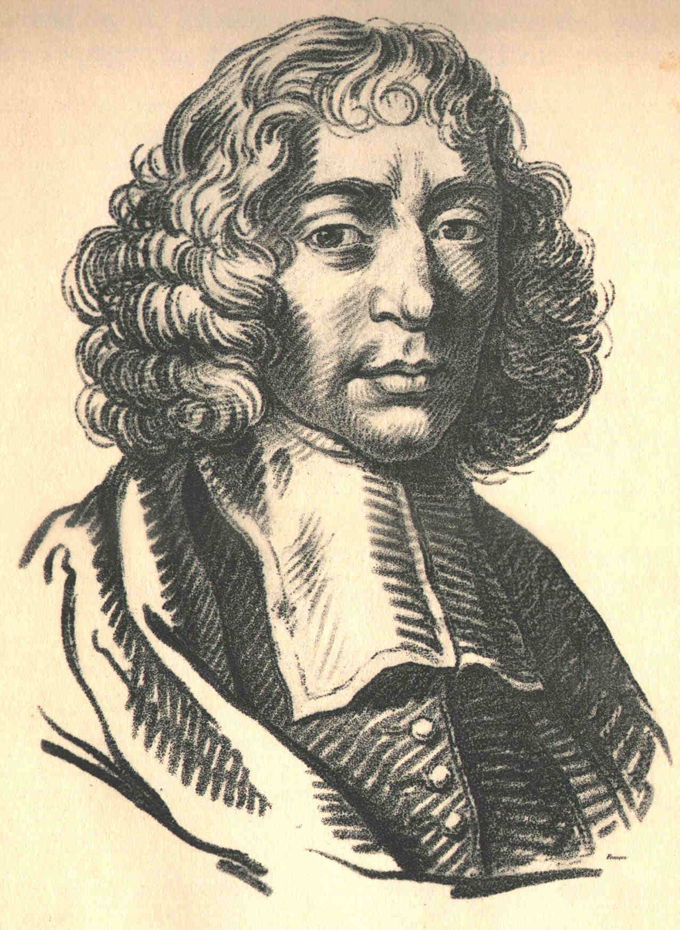
The Living Cosmos - from Oak Trees to the “Big Bang”
What consciousness does: the propositional account, contd.
Hypothesis: consciousness defines a window on reality by “asserting” its own being (Spinoza, Mathews: conatus)
This is one nested fragment of the “One work” of Eckhart
Exit via the gift shop
Notes:
Can now return to the question, what does consciousness do?
* Conatus via “assertion” (Zeno effect)
... That’s another story
All that’s left is to *

Slide 13
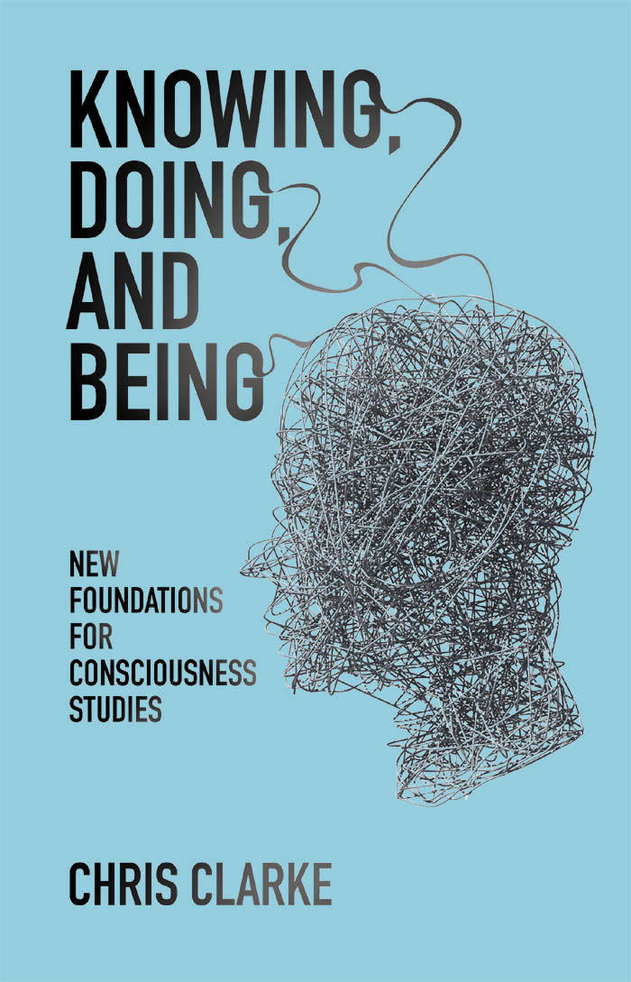
Knowing, Being, and Doing New Foundations for Consciousness Studies (Paperback – 1 Oct 2013) By Chris Clarke ISBN 9781845404550 Imprint Academic RRP £14.95 – PRICE ON IMPRINT ACADEMIC WEBSITE £11.96
This presentation and notes: www.scispirit.com/spirituality.htm

